Slide 1
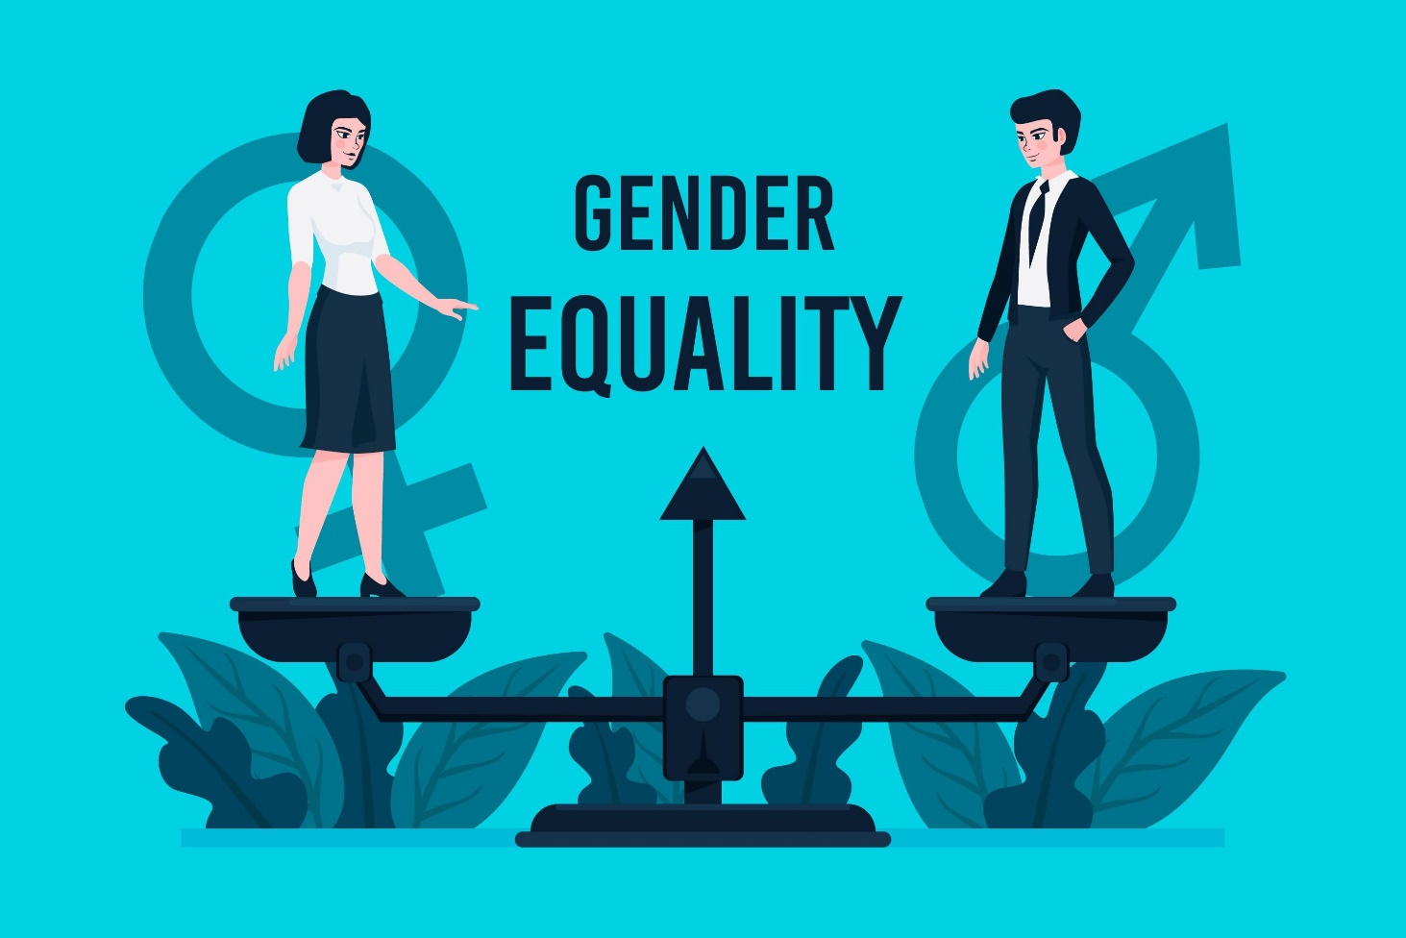

Slide 2
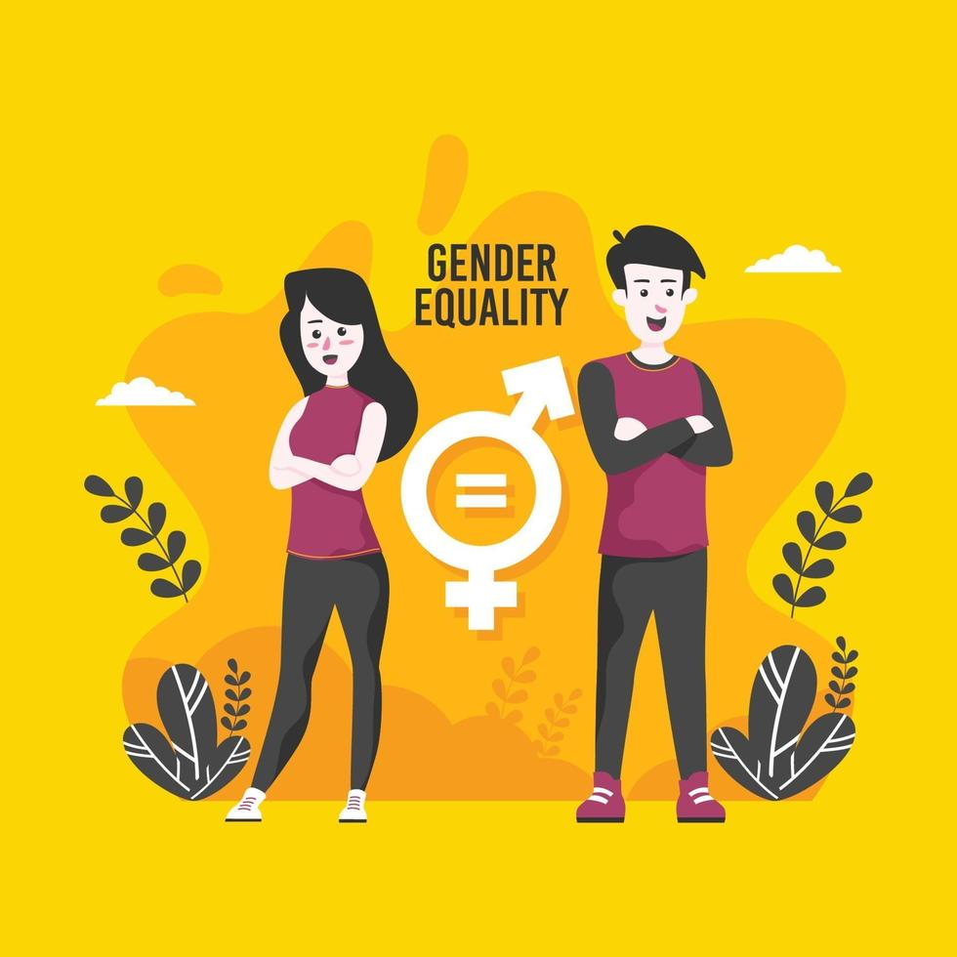
WHAT IS GENDER EQUALITY?
Gender equality is, first and foremost, a human right. It implies that women, men, boys and girls of all classes and races participate as equals and have equal value. They enjoy equal access to resources, freedoms and opportunities to exercise control.
Gender equality means that the rights, responsibilities and opportunities of individuals will not depend on whether they are male or female, handicapped or able bodied, young or elderly, white or black, or from rural or urban settings.

Slide 3
